Slide 1
Digital Portfolio
STUDENT NAME: G.AARTHI
REGISTER NO AND NMID: 1B78C83B0813FD387C347342D48337
DEPARTMENT: BCA-II year
COLLEGE: COLLEGE/ UNIVERSITY:Shree Ragavendra Arts and science College

Slide 2
PROJECT TITLE
Digital Portfolio
A Digital Portfolio is a personal website that displays an individual’s skills, education, project and achievement in a well- organized and attractive format.
It is designed using HTML,CSS and optionally Javascript to create a simple and responsive layout.

Slide 3


AGENDA
Problem Statement
Project Overview
End Users
Tools and Technologies
Portfolio design and Layout
Features and Functionality
Results and Screenshots
Conclusion
Github Link
3/21/2024 Annual Review

Slide 4

PROBLEM STATEMENT
Problem statement
To design and develop a personal portfolio website for a BCA student that
displays details such as profile, education, skills, and contact information in
a simple and responsive manner.
The website should:
Provide smooth navigation across sections like Home, About, Skills,
Education, and Contact.
Present information clearly with an attractive layout.
Work on both mobile and desktop devices.

Slide 5

PROJECT OVERVIEW
Project Overview – Digital Portfolio Website
1. Project Title:Personal Digital Portfolio
G.Aarthi BCA Student
2. Objective: To design and develop a responsive
portfolio website to showcase academic background,
skills, and contact details professionally.

Slide 6
PROJECT OVERVIEW
3. Key Features:
Navigation Bar – Links to Home, About, Skills, Education, and
Contact sections.
Hero Section – Displays name, title, location, and social links.
About Section – Overview of education and career interests.
Skills Section – Programming skills in Python, C++, and C.
Education Section – Academic details and learning focus.
Contact Form – Allows visitors to get in touch via email.
Responsive Design – Compatible with mobile and desktop devices.

Slide 7
PROJECT OVERVIEW
4. Technologies Used:
HTML5 – Structure of the website.
CSS3 – Styling and layout design.Font Awesome – Icons
for visual enhancement.
Javascript – Interactive features (toggle menu, contact
form).
5. Expected Outcome:
A professional-looking personal portfolio website that
highlights academic and career achievements, helping in
internships, job applications, and professional
networking.

Slide 8

WHO ARE THE END USERS?
1.Potential Employers / Recruiters
• To review your skills, education, and contact information
for internships or job opportunities.
2. College Faculty / Academic Evaluators
• To assess your project work, presentation, and technical
knowledge.
3. Peers / Collaborators
• Fellow students, developers, or friends who may want to
collaborate on projects.
4. General Visitors
• Anyone interested in learning about your background,
skills, and academic journey.

Slide 9

TOOLS AND TECHNIQUES
Tools Used
HTML5 – Structure and content of the
website.
CSS3 – Styling, layout, and visual design.
Font Awesome – Icons for navigation and
sections.
JavaScript – Interactivity (menu toggle,
form handling).
Code Editor(codepen/ easy coder web)–
For writing and edit Chrome code.
Web Browser(Chrome)– For testing and
running the website.

Slide 10
TOOLS AND TECHNIQUES
Techniques Used
Responsive Web Design (RWD) – Ensuring
website works on mobile, tablet, and desktop.
Navigation Bar Design – Smooth section linking
for user-friendly experience. Section-Based Layout – Dividing content into Hero, About, Skills, Education, and Contact sections. Form Handling Technique – Collecting user input in the contact form. Use of External Libraries – Font Awesome for icons.

Slide 11
POTFOLIO DESIGN AND LAYOUT
Design
Minimal & Professional Look – Clean and simple interface
with a focus on content.
Font Awesome Icons– For visual appeal and navigation
clarity.
Color Scheme – Soft background with readable text contrast. Typography – Clear headings and readable body text.
11

Slide 12
PORTFOLIO DESIGN AND LAYOUT
Layout
Navigation Bar – Fixed menu with Home, About, Skills, Education, and
Contact sections.
Hero Section – Name, title, location, and quick action buttons (LinkedIn, Contact). About Section – Personal introduction and highlights (Education Focus, Interests, Goals). Skills Section – List of technical skills (Python, C++, C). Education Section – Details of academic background and highlights. Contact Section – Contact details, social links, and message form. Footer – Copyright and brief info.

Slide 13
FEATURES AND FUNCTIONALITY
Features
1.Responsive Design – Works on desktop,
tablet, and mobile.
2. Navigation Bar – Easy access to all sections
(Home, About, Skills, Education, Contact).
3. Hero Section – Profile name, title, and
location displayed prominently.
4. Interactive Buttons – LinkedIn and contact
links open directly.
5. Font Awesome Icons – For better visual
representation of sections.
6. Contact Form – Users can send messages
directly.
7. Footer – Displays copyright and basic
information.

Slide 14
FEATURES AND FUNCTIONALITY
Functionality
Smooth Scrolling between
sections using navigation links.
Clickable Social Media Buttons to
redirect to LinkedIn. Form Submission to collect visitor messages (can be linked to email or database in future). Mobile-Friendly Layout ensuring proper alignment across all devices.

Slide 15

RESULTS AND SCREENSHOTS
Results
A fully functional personal digital portfolio website was
Created.
Showcases profile, education, skills, and contact
information in an interactive layout.
Responsive design works seamlessly on desktop and
mobile devices.
Provides easy navigation and direct LinkedIn integration.
3/21/2024 Annual Review
15

Slide 16
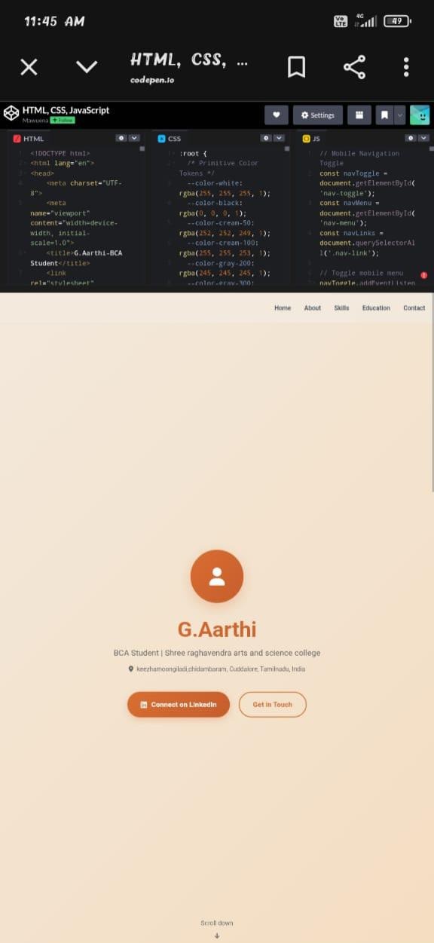
Screenshot
Homepage- showing name,title and avatar

Slide 17
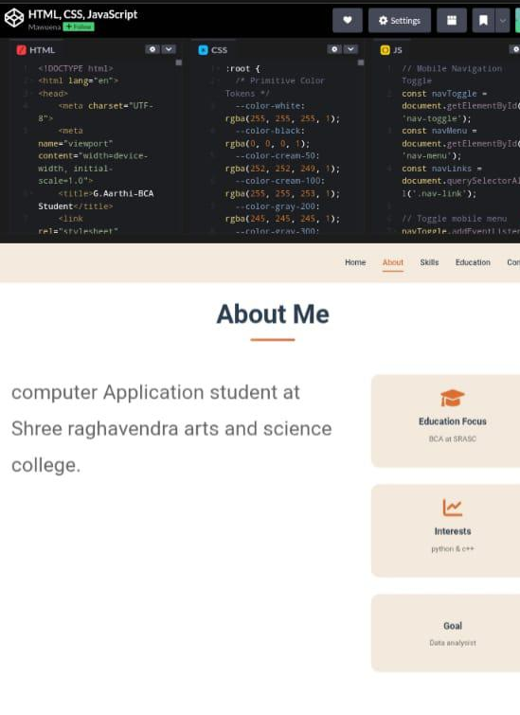
About section – Displaying bio and highlight

Slide 18
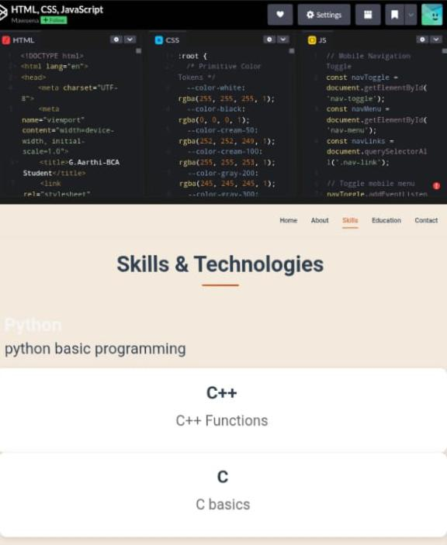
Skills section – Listing programming languages

Slide 19
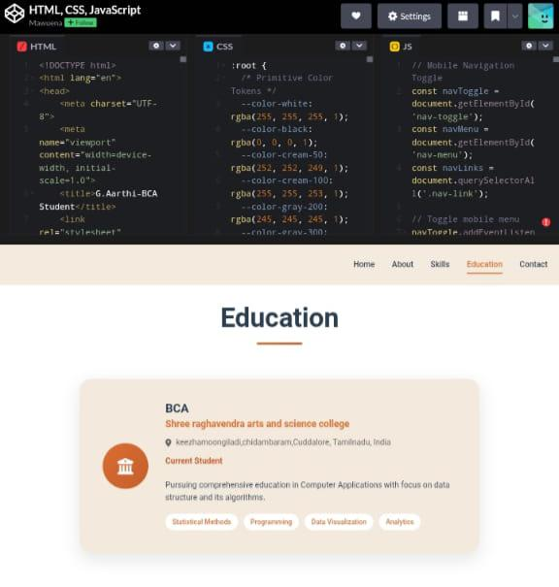
Education section – college name, course and highlight

Slide 20
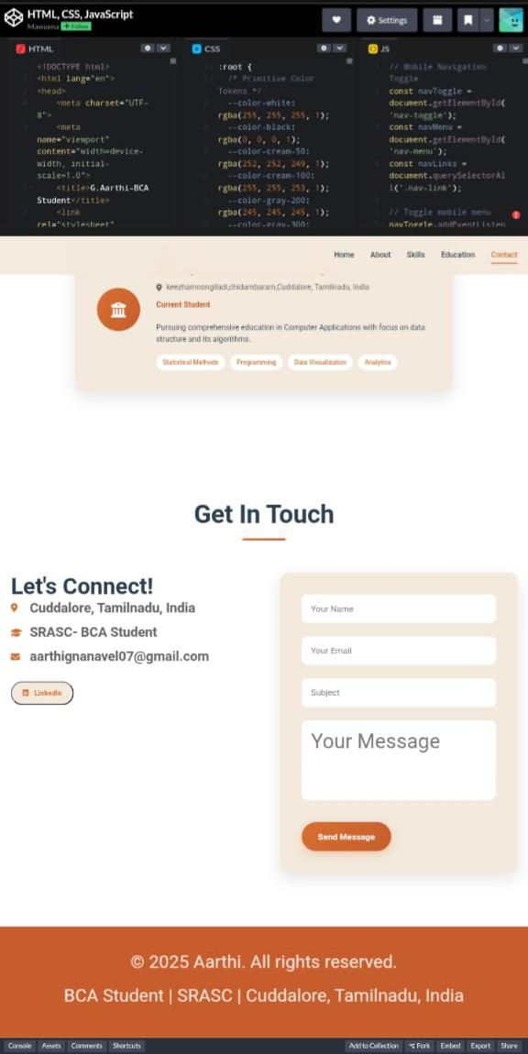
Contact section –Email,linkedin and contact form.

Slide 21
CONCLUSION
Conclusion for Digital Portfolio Project
“The Digital Portfolio effectively showcases my personal profile, academic background, technical skills, and career aspirations in an organized and visually appealing format. It serves as a professional platform for potential employers, faculty, and collaborators to learn about my abilities and achievements. The project demonstrates my knowledge of web development using HTML, CSS, and JavaScript and highlights my capability to create user-friendly and responsive designs.”
“THANK YOU”
21

